Slide 1
Chapter 12
Object Recognition

Slide 2
Patterns and Pattern Classes
Patterns and features
Pattern classes: a pattern class is a family of patterns that share some common properties
Pattern recognition: to assign patterns to their respective classes
Three common pattern arrangements used in practices are
  Vectors
  Strings
  Trees

Slide 3
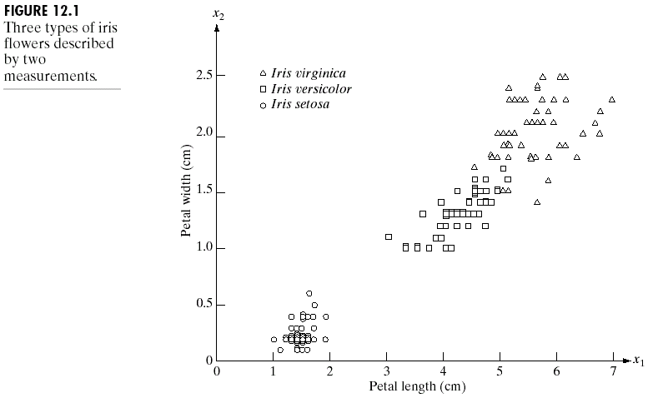
Patterns and Pattern Classes
Vector Example

Slide 4
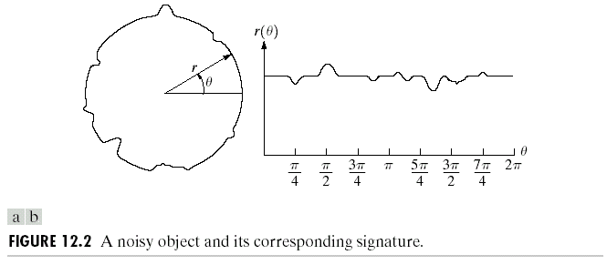
Patterns and Pattern Classes
Another Vector Example
Here is another example of pattern vector generation.
In this case, we are interested in different types of noisy shapes.

Slide 5
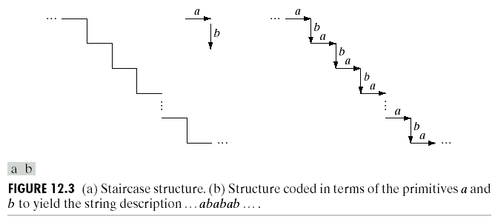
Patterns and Pattern Classes
String Example
String descriptions adequately generate patterns of objects and other entities whose structure is based on relatively simple connectivity of primitives, usually associated with boundary shape.

Slide 6
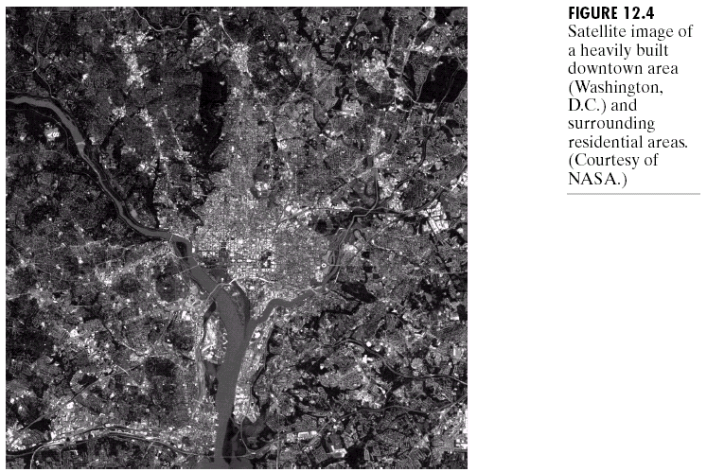
Patterns and Pattern Classes
Tree Example
Tree descriptions is more powerful than string ones.
Most hierarchical ordering schemes lead to tree structure.

Slide 7
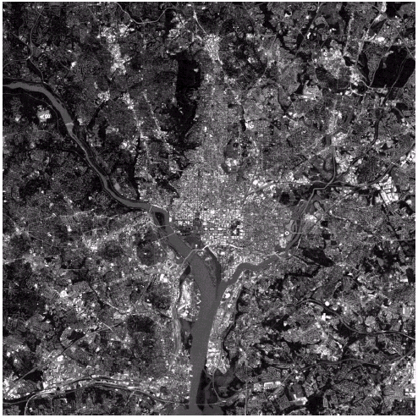
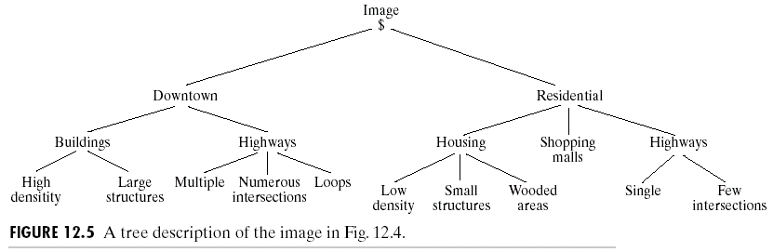
Patterns and Pattern Classes
Tree Example

Slide 8




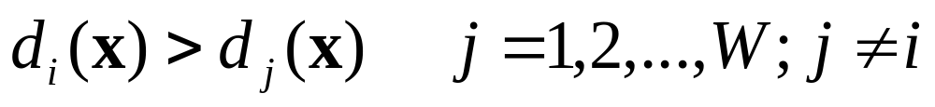

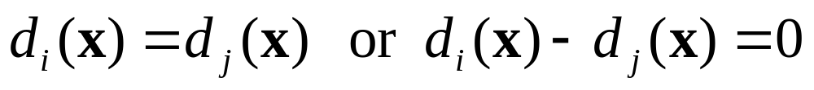
Recognition Based on
Decision-Theoretic Methods
Decision-theoretic approaches to recognition are based on the use decision functions.
Let represent an n-dimensional pattern vector. For W pattern classes , we want to find W decision functions with the property that, if a pattern x belongs to class , then
The decision boundary separating class and is given by

Slide 9
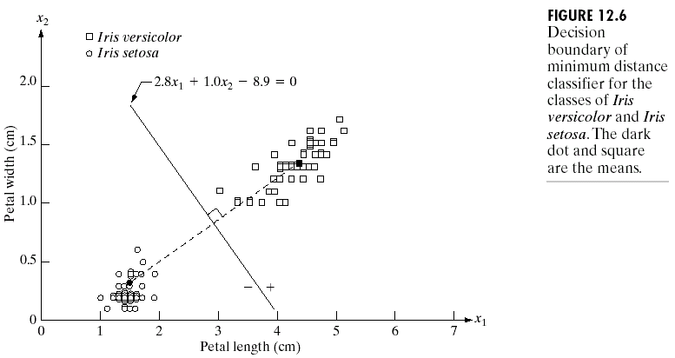
Recognition Based on Decision-Theoretic Methods
Matching
Minimum distance classifier

Slide 10
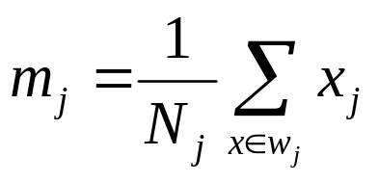
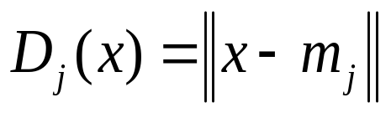
Minimum Distance Classifier
Suppose that we define the prototype of each pattern class to be the mean vector of the patterns of that class:
Using the Euclidean distance to determine closeness reduces the problem to computing the distance measures
j=1,2,…,W (1)
j=1,2,…,W (2)

Slide 11
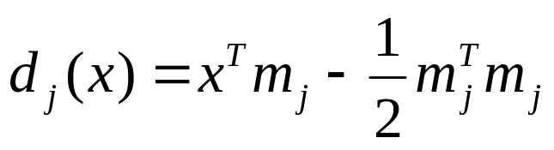
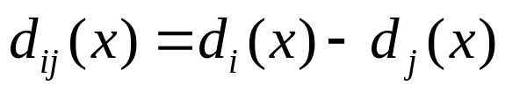
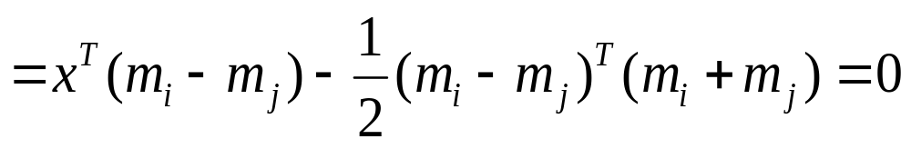
Minimum Distance Classifier
The smallest distance is equivalent to evaluating the functions
The decision boundary between classes and for a minimum distance classifier is
j=1,2,…,W (3)
j=1,2,…,W (4)

Slide 12
Minimum Distance Classifier
Suppose that we define the prototype of each pattern class to be the mean vector of the patterns of that class:
Using the Euclidean distance to determine closeness reduces the problem to computing the distance measures
j=1,2,…,W (1)
j=1,2,…,W (2)

Slide 13
Minimum Distance Classifier
The smallest distance is equivalent to evaluating the functions
The decision boundary between classes and for a minimum distance classifier is
j=1,2,…,W (3)
j=1,2,…,W (4)

Slide 14
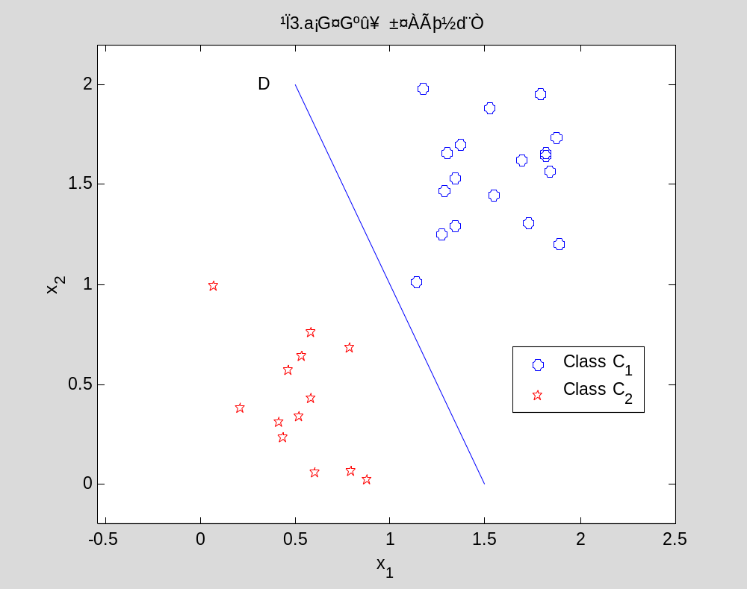
Minimum Distance Classifier
Decision boundary of minimum distance classifier

Slide 15
Minimum Distance Classifier
Advantages:
1. Unusual direct-viewing
2. Can solve rotation the question
3. Intensity
4. Chooses the suitable characteristic,
then solves mirror problem
5. We may choose the color are one kind
of characteristic, the color question
then solve.

Slide 16
Minimum Distance Classifier
Disadvantages:
1. It costs time for counting samples,
but we must have a lot of
samples for high accuracy, so it is
more samples more accuracy!
2. Displacement
3. It is only two features, so that the
accuracy is lower than other methods.
4. Scaling

Slide 17
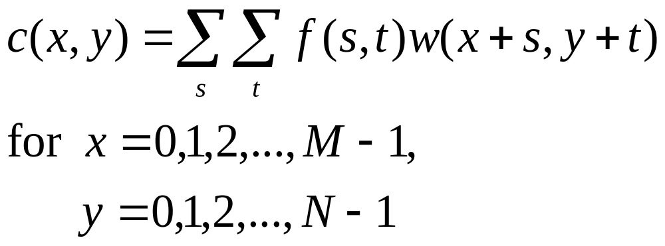
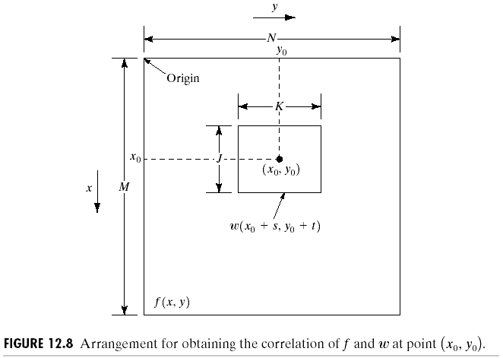
Recognition Based on Decision-Theoretic Methods
Matching by Correlation
The correlation between f(x,y) and w(x,y) is

Slide 18
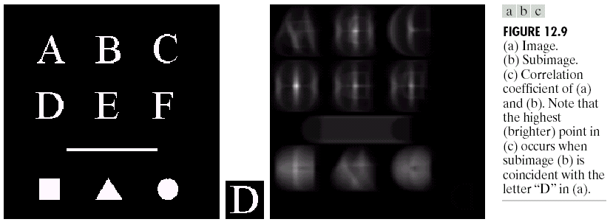
Recognition Based on Decision-Theoretic Methods
Matching by Correlation

Slide 19
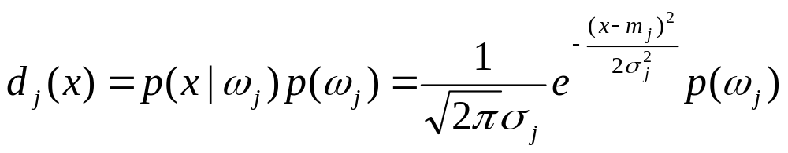
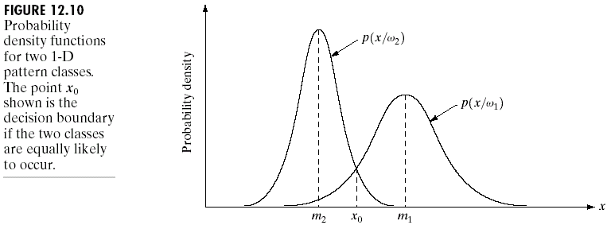
Recognition Based on Decision-Theoretic Methods
Optimum Statistical Classifiers
Bayes classifier for Gaussian pattern classes

Slide 20
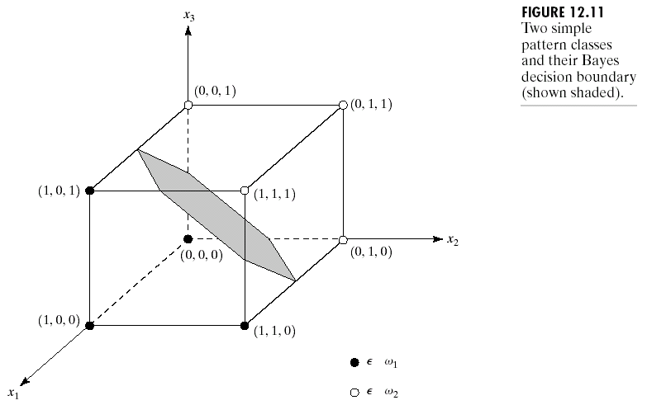
Recognition Based on Decision-Theoretic Methods
Optimum Statistical Classifiers

Slide 21
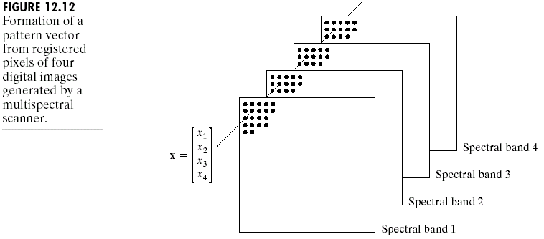
Recognition Based on Decision-Theoretic Methods
Optimum Statistical Classifiers
Classification of multi-spectral data using the Bayes classifier

Slide 22
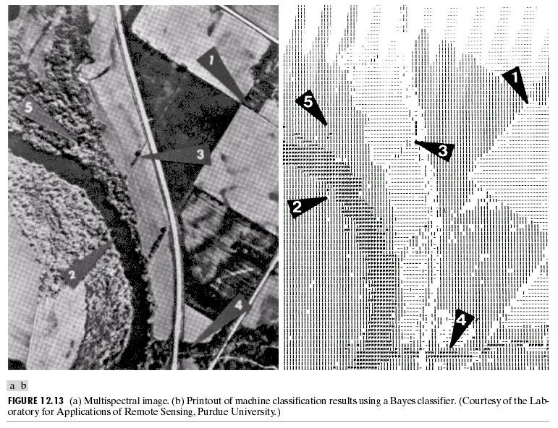
Recognition Based on Decision-Theoretic Methods
Optimum Statistical Classifiers

Slide 23
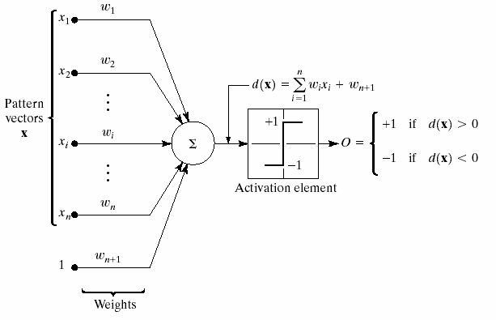
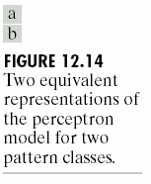
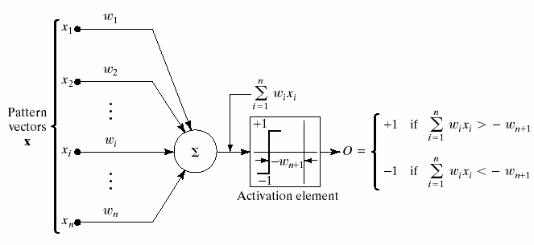
Recognition Based on Decision-Theoretic Methods
Neural Networks

Slide 24
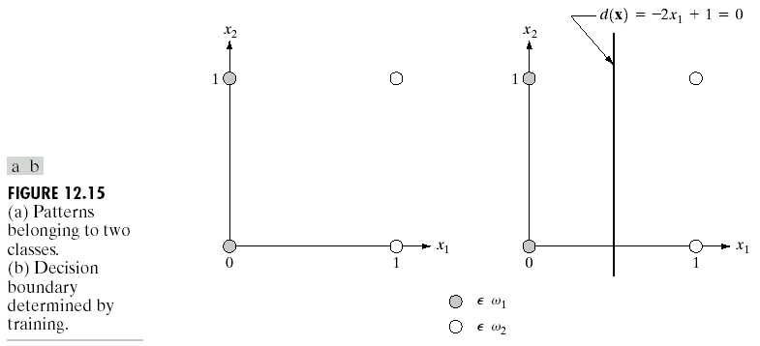
Recognition Based on Decision-Theoretic Methods
Neural Networks
Illustration of the perceptron algorithms

Slide 25
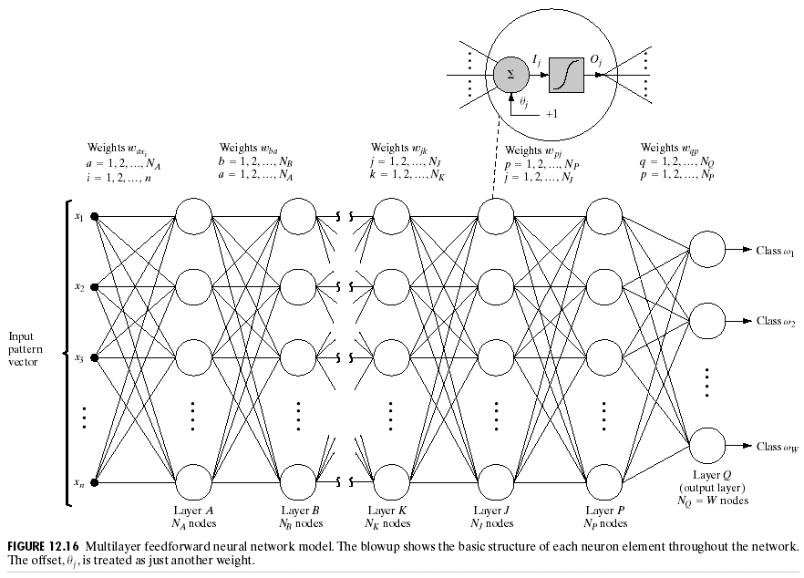
Recognition Based on Decision-Theoretic Methods
Multilayer Feedforward Neural Networks

Slide 26
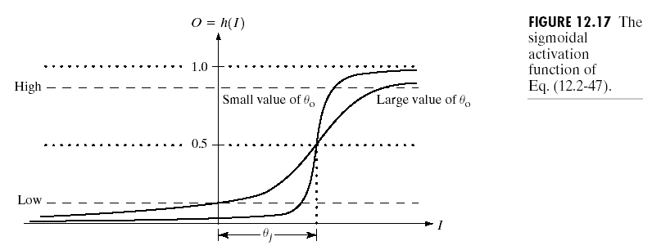
Recognition Based on Decision-Theoretic Methods
Multilayer Feedforward Neural Networks
The activation function: a sigmoid function

Slide 27
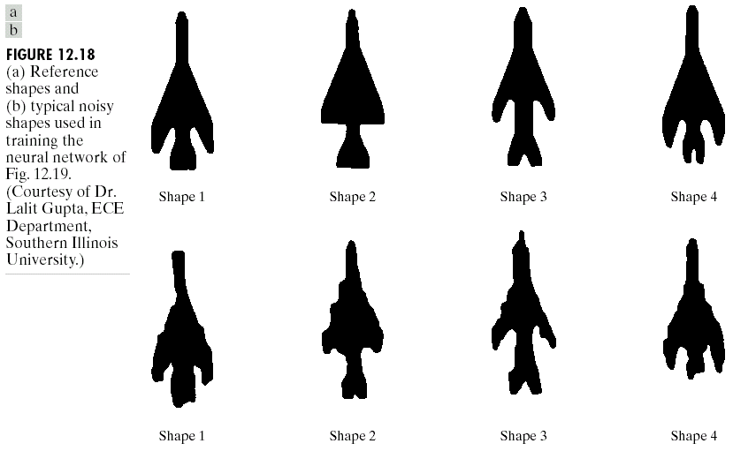
Recognition Based on Decision-Theoretic Methods
Multilayer Feedforward Neural Networks
Pattern vectors were generated by computing the normalized
signatures of the shapes (see Section 11.1.3)

Slide 28
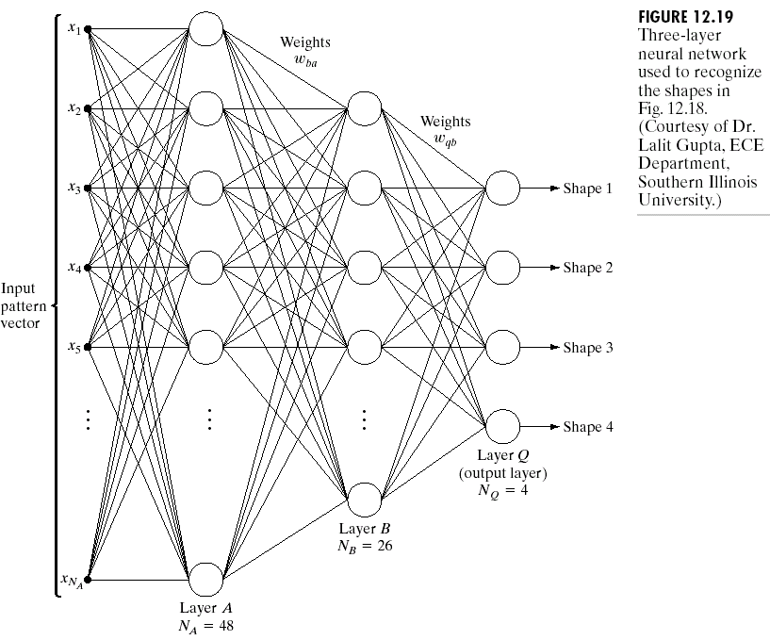
Recognition Based on Decision-Theoretic Methods
Multilayer Feedforward Neural Networks

Slide 29
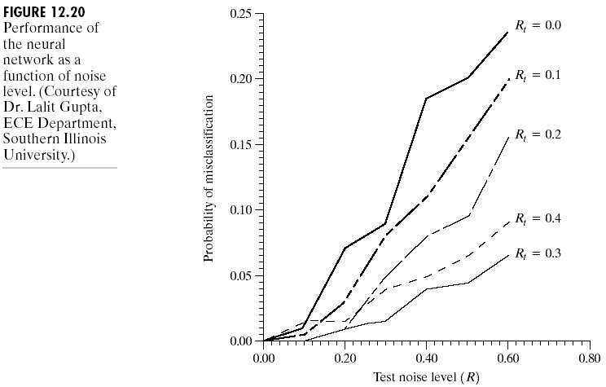
Recognition Based on Decision-Theoretic Methods
Multilayer Feedforward Neural Networks
R_{t} denote a value of R
used to generate
training data.
Rt =0 implies noise-free
training.

Slide 30
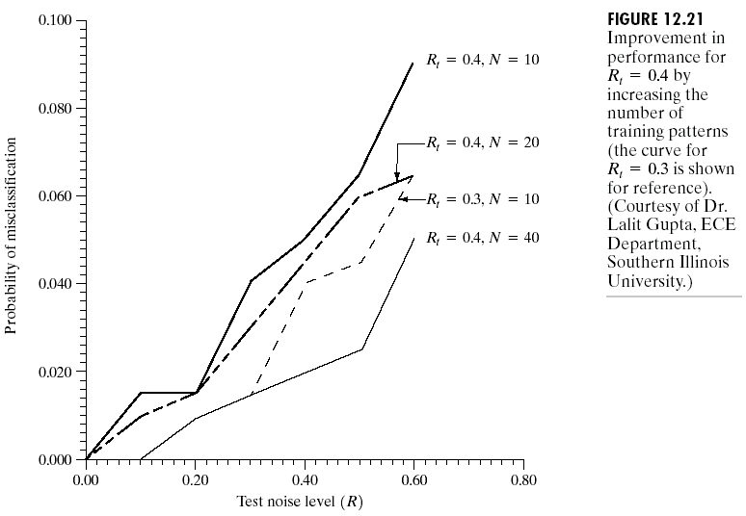
Recognition Based on Decision-Theoretic Methods
Multilayer Feedforward Neural Networks
N: the number of
training patterns

Slide 31
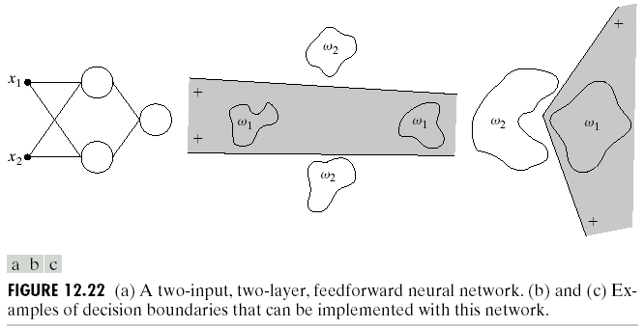
Recognition Based on Decision-Theoretic Methods
Multilayer Feedforward Neural Networks
Complexity of decision surface
  Two input, tow-layer, feedforward neural networks

Slide 32
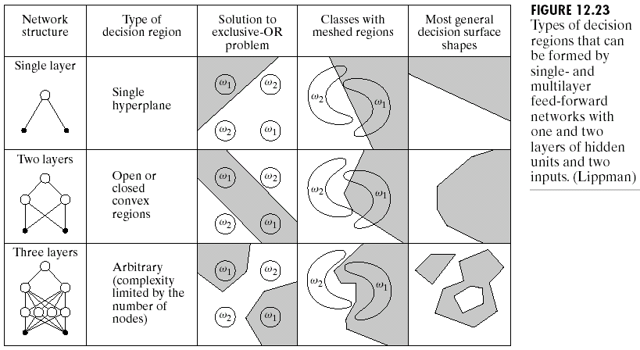
Recognition Based on Decision-Theoretic Methods
Multilayer Feedforward Neural Networks

Slide 33
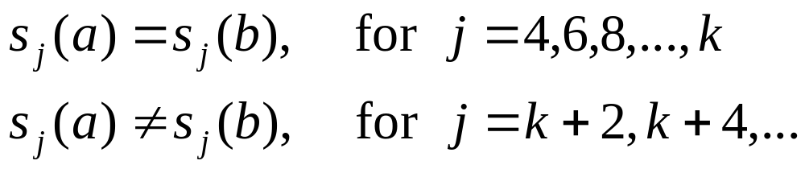
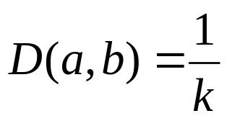
Structural Methods
Matching Shape Number
Let a and b denote shape numbers of closed boundaries represented by 4-directional chain codes. There two shapes have a degree of similarity k if
where s indicates shape number and the subscript indicates order (see Section 11.2.2)
The distance between two shapes a and b defined as

Slide 34
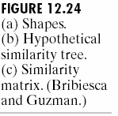
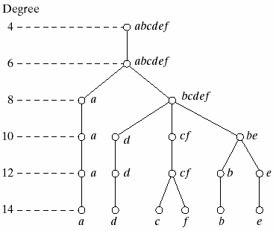
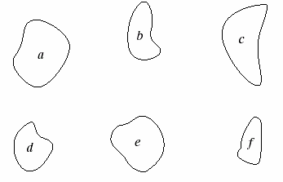
Structural Methods
Matching Shape Number
Shape no. order
Similarity tree

Slide 35
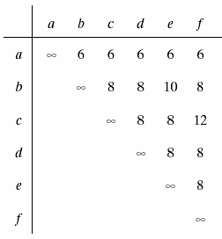
Structural Methods
Matching Shape Number
Similarity tree
Similarity matrix

Slide 36

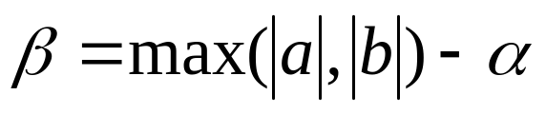
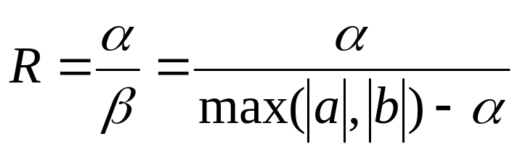
Structural Methods
String Matching
Suppose that two region boundaries, a and b, are coded into strings (see Section 11.5) denoted a1, a2, …, a_{n} and b1, b2, …,b_{m}, respectively.
Let represent the number of matches between the two strings, where a match occurs in the kth position if a_{k} = b_{k} .
The number of symbols that do not match is
A simple measure of similarity between a and b is the ratio

Slide 37
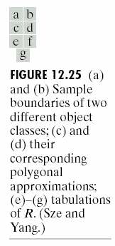
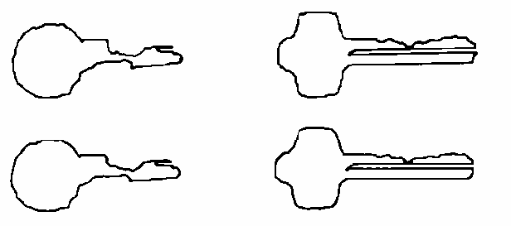


Structural Methods
String Matching
Strings were formed from the polygons by computing the interior angle, , between segments as each polygon was traversed clockwise.
Angles were coded into one of eight possible symbols, corresponding to 45º increments.

Slide 38
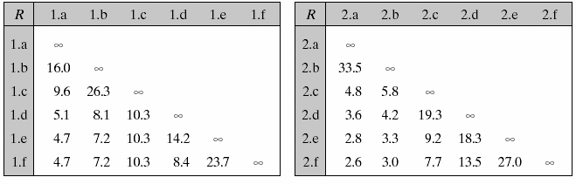
Structural Methods
String Matching
Figure 12.25(e) shows the results of computing the measure R for six samples of object 1 against themselves.
The notation 1.c refers to the third string from object class 1.
Figure 12.25 (e)
Figure 12.25 (f)

Slide 39
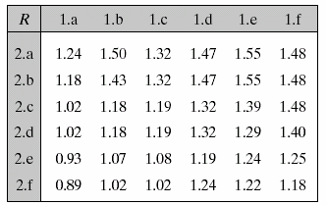
Structural Methods
String Matching
Figure 12.25(g) shows a tabulation of R values obtained by comparing strings of one class against the other.
Note that all R values are considerable smaller than any entry in the two preceding tabulations.
The R measure achieved a
high degree of discrimination
between the two classes of
objects.
Figure 12.25 (g)

Slide 40
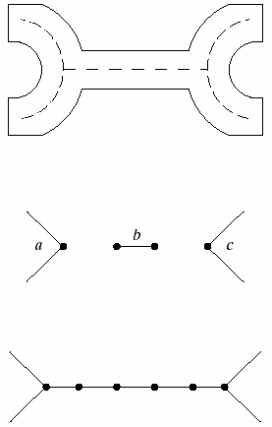
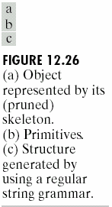
Structural Methods
Syntactic Recognition of Strings
String grammars
  Step1: Object class
  generation using a
  regular string
  grammar
  For example:
  the srting of Fig. 12.26(c) is abbbbbc.

Slide 41
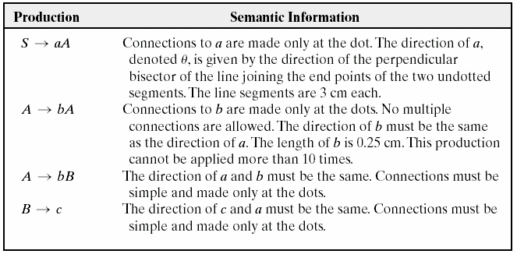
Structural Methods
Syntactic Recognition of Strings
String grammars
  Step 2: use of semantics (production rules)

Slide 42


Structural Methods
Syntactic Recognition of Strings
String grammars
  Step 3: automata as string recognizers
String: abbbbbc

Slide 43


Structural Methods
Syntactic Recognition of Trees
Tree grammars
Production rules
  Example
  S → a
  |
  X₁
  X₁ → c
  / \
  X₂ X₃
Tree automata

Slide 44

Structural Methods
Syntactic Recognition of Trees
Processing stages of a tree automata

Slide 45

Structural Methods
Syntactic Recognition of Trees

Slide 46

Structural Methods
Syntactic Recognition of Trees

